Slide 1
Implementation of The Mayo Clinic Expanded Access
Protocol: Expanded Access to Convalescent Plasma for the Treatment of Patients with COVID-19
Dial in (Main): (415) 655-0052
Dial in (Alt): (951) 266-6125
Access Code: 309-261-051
Slides in “Handout” Tab
C. Karen Jeans, PhD, CCRN, CIP
Director, Regulatory Affairs, ORPP&E
VHA Office of Research & Development
April 30, 2020

Slide 2
Discussion Topics
Implementation of the Protocol Process for initiating the Mayo Clinic Convalescent Plasma Expanded Access Program
  Key Changes that have occurred in processes and documents
  Communication with the Mayo Clinic IRB
  R&D Committee approval
  Informed Consent
  Protocol required reporting
Use of iMED Consent by VA Facilities for the Mayo Clinic Convalescent Plasma Expanded Access Program

Slide 3
Why is COVID-19 Convalescent Plasma Being Administered to Patients with COVID-19?
Patients with COVID-19 may improve faster if they receive plasma from those who have recovered from COVID-19, because it may have the ability to fight the virus that causes COVID-19.
Initial data available from studies using COVID-19 convalescent plasma for the treatment of individuals with severe or life-threatening disease indicate that a single dose of 200 mL showed benefit for some patients, leading to improvement.
COVID-19 convalescent plasma has not yet been demonstrated to provide clinical benefit in patients affected by this disease.
It's not known if this treatment will or will not help those with COVID-19 or if it will have any harmful effects, but this is one of the only treatments that we have at present.

Slide 4
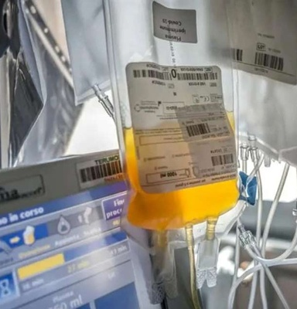
COVID-19 Convalescent Plasma
COVID-19 convalescent plasma has not yet been approved for use by FDA, it is regulated as an investigational product.
Only two pathways can be used to administer or study the use of COVID-19 convalescent plasma.

Slide 5
Pathways to Administer or Study COVID-19 Convalescent Plasma
Clinical Trials
Expanded Access
Emergency
Use IND
Treatment IND

Slide 6
Research Committees Involved in the Review or Approval of VA Physician Requests for Convalescent Plasma for COVID-19: Emergency Use IND vs. Treatment Use IND (Mayo Clinic Expanded Access Protocol)
Single Patient
Emergency IND
For Convalescent Plasma
No Prospective IRB Approval
IRB Notification Required 5 Working Days After Beginning Administration to the IRB of Record
(NOT MAYO CLINIC IRB)
No VA Research and Development Committee approval
Treatment IND for Convalescent Plasma (Mayo Clinic Expanded Access Protocol)
Multiple Patients
Prospective Mayo Clinic IRB Approval Required: Done April 1, 2020
No SRS Review No Local Privacy Officer Review
No Local ISSO Review
(National PO and Information Security Reviews Conducted)
Prospective VA Research and Development Committee approval Required
*Designated Review can be used

Slide 7
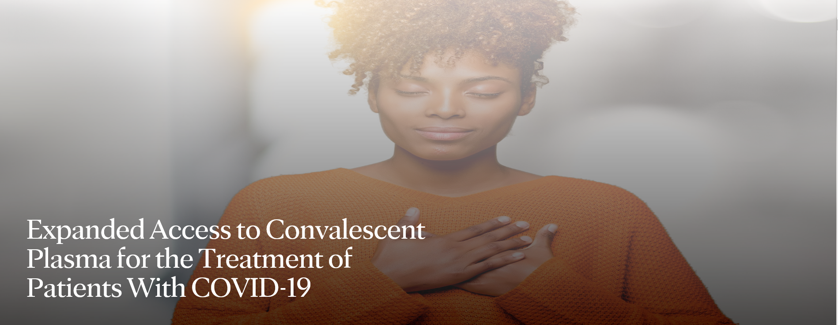
Expanded Access Program: Expanded Access to Convalescent Plasma for the Treatment of
COVID-19
https://www.uscovidplasma.org

Slide 8
Status of Program: Mayo Clinic Expanded Access to Convalescent Plasma for the Treatment of
COVID-19
Category | April 14, 2020 | April 28, 2020
Sites Registered | 1046 | 2144
Physicians | 952 | 3835
Patients Enrolled | 436 | 6563
Number of Patients Who Have Completed Transfusions | 118 | 3008

Slide 9

Mayo Clinic IRB of Record
Selected as IRB of Record by the FDA for this Expanded Access Treatment IND
The IRB Reliance Agreement between ORD and the Mayo Clinic IRB only applies to VA Facilities registered for the Mayo Clinic Expanded Access to Convalescent Plasma for the Treatment of
COVID-19.

Slide 10
ORD’s Expanded Access Program for VA Facilities Without Federalwide (FWA) Assurances
ORD established a research infrastructure to allow the 31 VA Medical Facilities without FWAs the opportunity to participate in expanded access programs using investigational drugs for COVID-19.
  Office of Research Oversight worked with ORD to develop the Special Assurance for these VA Facilities and applicable MOUs.
  The Baltimore VA R&D Committee is the R&D Committee for the VA Medical Centers without FWAs.
  Network of volunteer VA study coordinators
    Over 100 VA volunteers offered to support the program

Slide 11
ORD’s Expanded Access Program for VA Facilities Without Federalwide (FWA) Assurances
14 VA Facilities without FWAs have indicated interest in participating.
6 VA Facilities have completed all agreements and MOUs to participate in the Mayo Clinic Expanded Access to Convalescent Plasma for the Treatment of COVID-19.
One VA has already registered a patient.

Slide 12
ORD’s Expanded Access Program for VA Facilities Without Federalwide (FWA) Assurances
The program is comprised of a volunteer team of experienced VA clinical trial personnel.
Individual VA team members are assigned to VA Facilities without FWAs to help guide physicians/Principal Investigators.
An additional group of volunteers has also been established to develop tools and guidance documents to assist all VA Facilities conducting the Mayo Clinic Expanded Access to Convalescent Plasma for the Treatment of COVID-19.

Slide 13
VA Facilities Participating in the Mayo Clinic Expanded Access to Convalescent Plasma for the Treatment of
COVID-19 Mayo Clinic
82 VA Facilities that have registered as Institutions.
82 VA Facility Medical Center Directors have signed the ORD Form: “Concurrence with the Office of Research and Development (ORD) Agreement with Mayo Clinic Institutional Review Board (IRB) For Mayo Clinic IRB Oversight”.
The VA Facility does not have ORD and ORO approval to use the Mayo Clinic IRB for this Expanded Access Program without submission of this form to ORD and ORO.

Slide 14
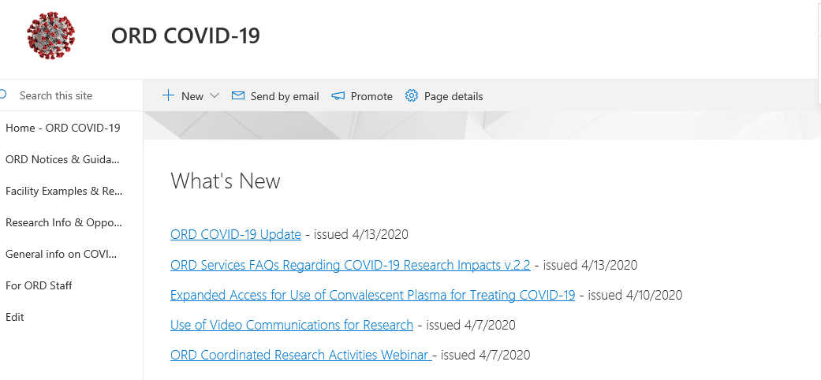
ORD COVID-19 Sharepoint site
https://dvagov.sharepoint.com/sites/vacovhacomm/admin/projects/covid19/SitePages/ORD-Communications.aspx.

Slide 15
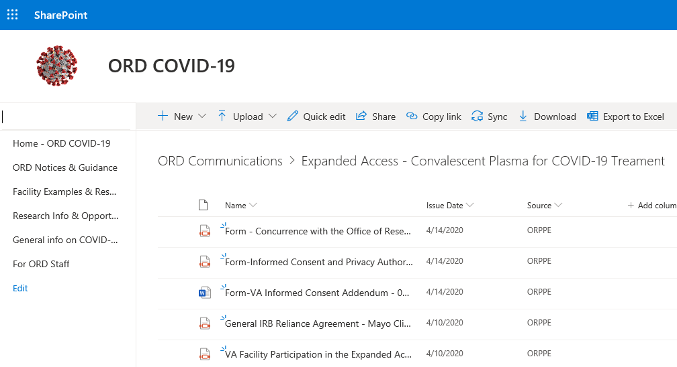
MCD Signs the Concurrence Memo after Reviewing the IRB Reliance Agreement
Shows your facility’s commitment to uphold the agreement the CRADO signed.

Slide 16
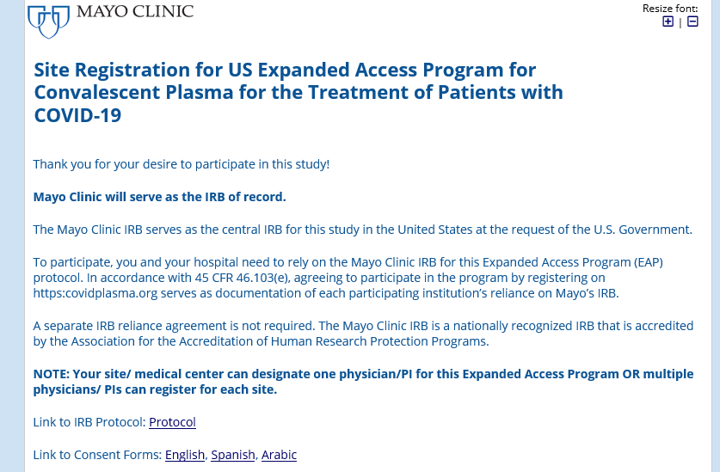
VA Facility Registration
After submitting your document to ORD and ORO your research office (or someone representing your facility if you don’t have a research office) will register your facility.
No changes to the VA Facility’s FWA are required: Do not add the Mayo Clinic IRB.

Slide 17
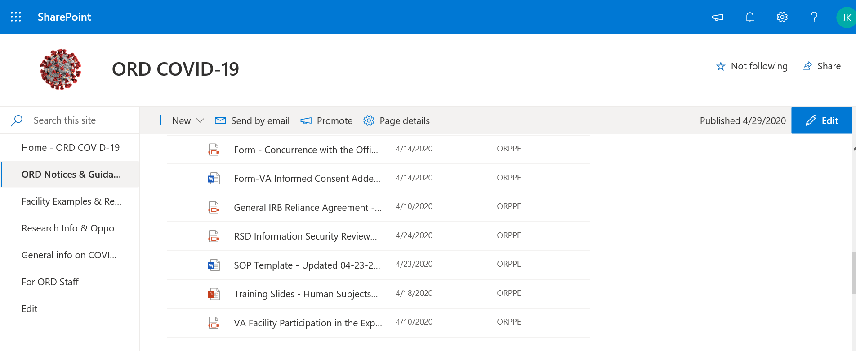
After Registration:
Update Standard Operating Policy for Use of the Mayo Clinic IRB

Slide 18

This is Where Process Changes Begin Compared to Two Weeks Ago

Slide 19
After Registration:
Update Standard Operating Policy for Use of the Mayo Clinic IRB
Significant Changes in Standard Operating Policy for Use of the Mayo Clinic IRB
  Provided clarification that local PO and ISSO review is not required
    VHA Privacy conducted a national privacy review.
    Office of Information Security Research Support Division performed national review of Mayo Clinic REDCap; documentation on ORD’s COVID-19 SharePoint site.
  Eliminated references to research service and VA Investigators requesting access to the Mayo Clinic IRB cloud server or Mayo Clinic IRB E-IRB system.
  Local research sites will not need to obtain copies of Mayo Clinic IRB minutes or Mayo Clinic IRB Rosters.

Slide 20
After Registration:
Update Standard Operating Policy for Use of the Mayo Clinic IRB (cont.)
Clarified no Safety Review Subcommittee (SRS) approval required.
Clarified that all serious adverse event reporting will go thru the Mayo Clinic Convalescent Plasma portal using the specified forms.
Included information regarding informed consent option for an exception from informed consent when written informed consent cannot be obtained from the subject or the subject’s Legally Authorized Representative.

Slide 21

Next Change: Physician/Principal Investigator Registration

Slide 22
Physician/Principal Investigator Registration
Unchanged:
VA Facilities can have multiple registered Physicians.
Each physician is a Principal Investigator.
Physicians register prior to VA Facility R&D Committee approval.
Physicians receive email after Physician/PI Registration.
Changed :
Physicians sign a Form FDA 1572 at the time of physician registration through electronic data capture.
Registered Physician receives completed FDA Form 1572 from Mayo Clinic after Physician/PI Registration.

Slide 23
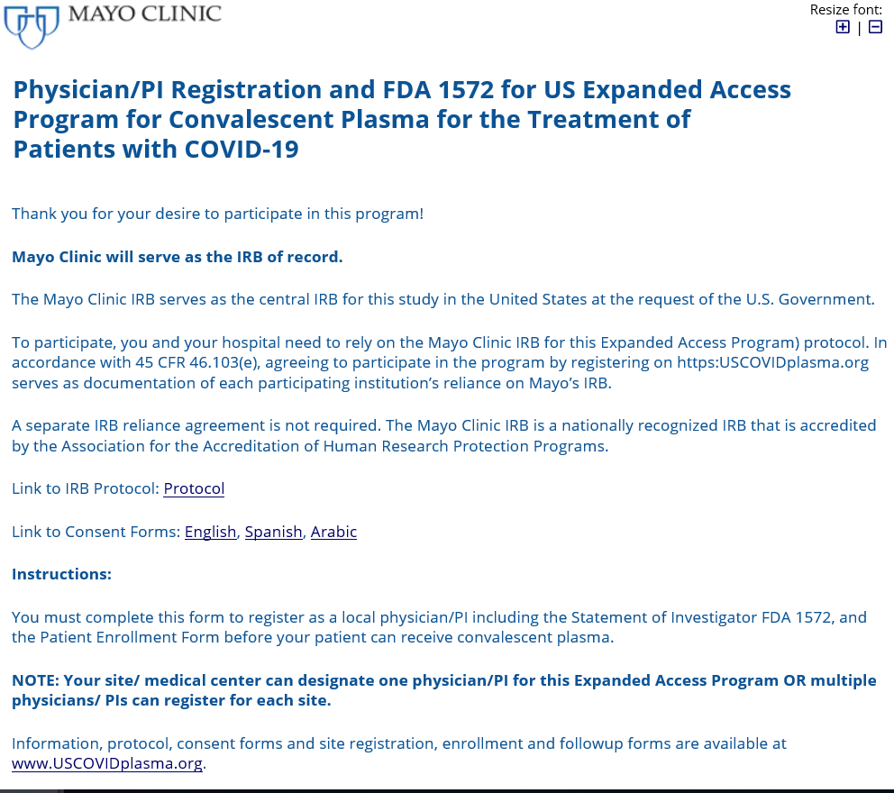
Physician Registration
https://redcap2.mayo.edu/redcap/surveys/?s=N44T8M9PED

Slide 24
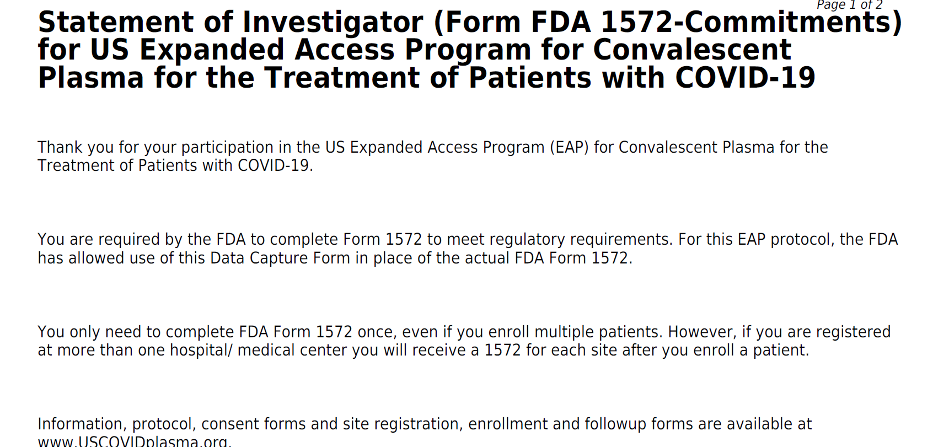
Physician/Principal Investigator Receives Registration: Example

Slide 25
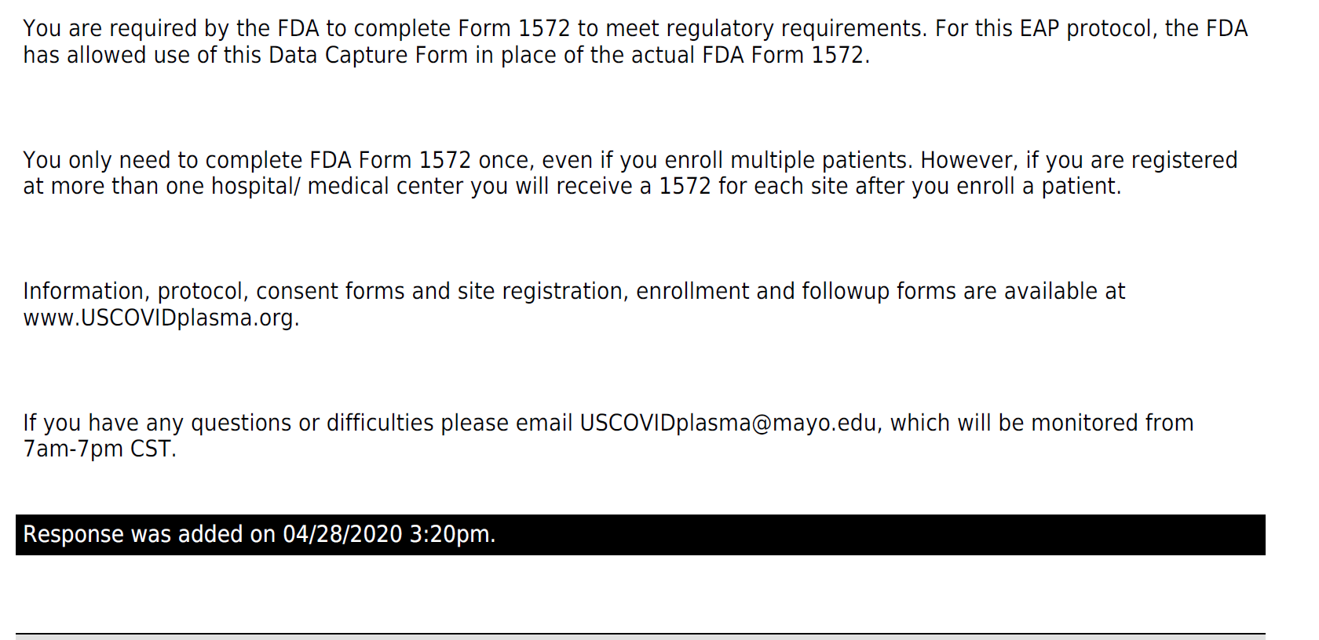
Physician/Principal Investigator Receives Registration: Example (cont.)
This is the Date your VA Physician/PI is approved by the Mayo Clinic IRB

Slide 26


R&D Committee Review
One R&D Committee approval required (even for multiple
Investigators/Physicians)
R&D Committee can use designated review process
No SRS review
No Local Privacy Officer review
No Local ISSO review
No R&D Committee continuing review

Slide 27
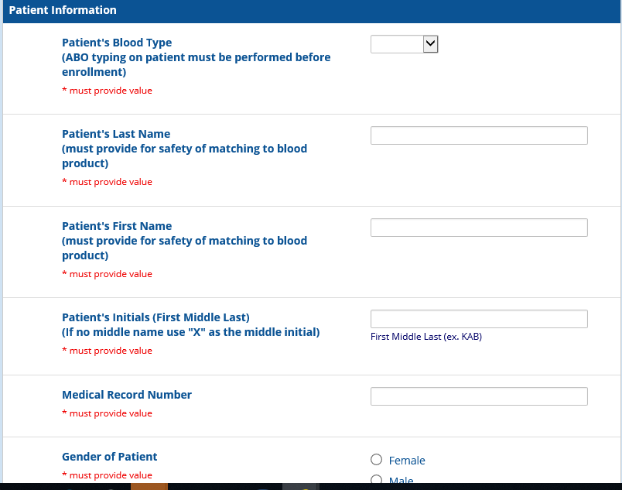
Following R&D Committee Approval and ACOS/R&D Notification:
Patient Registration
https://redcap2.mayo.edu/redcap/surveys/?s=R3DHR7X8N4

Slide 28
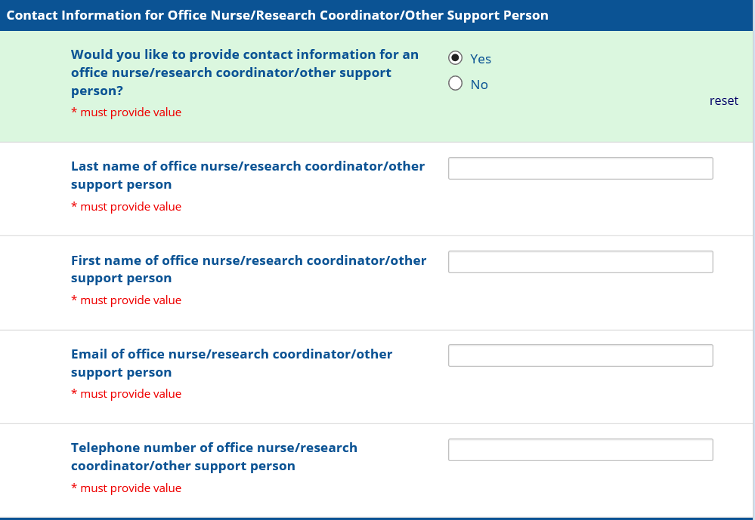
Patient Registration:
Contact Information for Office Nurse/Research Coordinator
https://redcap2.mayo.edu/redcap/surveys/?s=R3DHR7X8N4

Slide 29
Information Received by the Physician/Principal Investigator Following Patient Registration
From: US Covid Plasma <uscovidplasma@mayo.edu>
Sent: Thursday, April 30, 2020 2:00 P.M.
To: PI/Physician; Office Nurse/Research Coordinator Subject: [EXTERNAL] AUTHORIZATION NOW COMPLETE: Your patient is now enrolled in the US COVID Plasma EAP (Patient Code: 4 digit code given)
Thank you Dr. X for enrolling PATIENT NAME (DOB: XX-XX-XXXX) in the US Expanded Access Program for Convalescent Plasma for the Treatment of Patients with COVID-19.
The assigned patient code is (4 digit code given).
Please retain this unique patient code as it is needed for all patient forms.
You are now authorized to contact your hospital blood bank and ask them to order a unit of COVID convalescent plasma from the American Red Cross or whichever source your hospital is using for blood products.
The American Red Cross/Vitalant/OneBlood/ABC/Local Source will determine when convalescent plasma is available and deliver it as soon as possible. This may be a longer wait than typical blood products.

Slide 30
Information Received by the Physician/Principal Investigator Following Patient Registration (cont.)
You will receive the Statement of Investigator Form FDA 1572 around 24hrs after completion of the Patient Enrollment Form. It is a regulatory requirement to complete this regulatory form as soon as possible after receipt.
You are required by Federal Regulation to report Serious Adverse Events (SAEs), which can be found in the Initial Data Collection Form (4-hour post-transfusion).
You will need to complete additional forms for each of your patients. Please retain each unique patient code assigned at the time of enrollment. You are responsible to keep these codes.
Click this link for next patient enrollment form: https://redcap2.mayo.edu/redcap/surveys/?s=R3DHR7X8N4
Information, protocol, consent forms and site registration, enrollment and followup forms are available at www.USCOVIDplasma.org.

Slide 31
Protocol Required Reporting by Physician/Principal Investigator
4 hour report:
  Post transfusion or if transfusion not given
7 day report: Please note that Day 0 is date of infusion.
Serious Adverse Event Report:
  Report any patient safety, expected or unexpected Serious Adverse Events (SAEs) occurring between 4 hour post-transfusion and thru Day 7
30 day report:
  Only complete if patient remains hospitalized
https://www.uscovidplasma.org/physicians-steps

Slide 32

Additional Changes:
Protocol: 04-15-2020
  Clarified 1-2 units of plasma and up to 500 mls delivered
Informed Consent: 4-15-2020
  Added risks:
    The risks to pregnancy are unknown.
    Unknown risks
    Risk of loss of confidentiality of private information

Slide 33

Informed Consent Documentation for Implementation of The Mayo Clinic Expanded Access Protocol: Expanded Access to Convalescent Plasma for the Treatment of Patients with COVID-19
The Mayo Clinic IRB has approved three (3) methods of informed consent for the Mayo Clinic Expanded Access Protocol.
The use of the options are sequential. Do not proceed straight to Option #3 before going to Option #1, then Option #2.

Slide 34
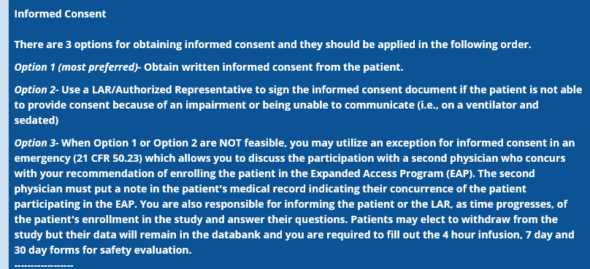
Informed Consent: 3 Options Approved by the Mayo Clinic IRB

Slide 35
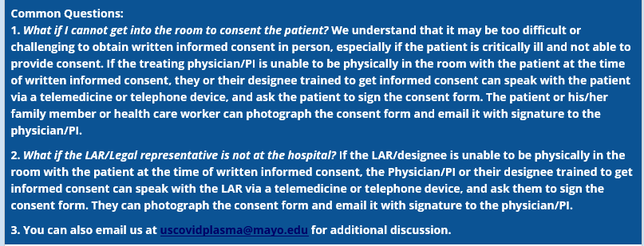
ICF Common Questions
You must consent using the Mayo Clinic IRB Informed Consent/Authorization and VA Informed Consent Addendum Unless Option #3 is used.

Slide 36
Informed Consent
The Informed Consent approved by the Mayo Clinic IRB and VA Informed Consent Addendum cannot be altered.
The Mayo Clinic IRB will allow a cover sheet to be added to the consent form to include information unique to the institution’s operations.
The VA Informed Consent Addendum is located in the Expanded Access Convalescent Plasma folder on the ORDCOVID-19 SharePoint site.
If iMED electronic consent is not used, please download the latest IRB-approved version of the Mayo Clinic consent at https://www.uscovidplasma.org/

Slide 37
COVID-19 Convalescent Plasma Issues
If your VA Facility is having problems or issues requesting or obtaining COVID-19 Convalescent Plasma (CCP) from your blood supplier, please email covidexpandedcoord@va.gov and put “PLASMA” in the subject line.
If your VA Facility’s blood bank supplier does not have convalescent plasma availability, they can order through the Red Cross. https://plasma.app.redcross.org/ConvalescentPlasmaDonorRequest/Order/Create

Slide 38
Summary for Part 1
There are many changes in processes occurring in the Mayo Clinic Expanded Access
Protocol: Expanded Access to Convalescent Plasma for the Treatment of Patients with COVID-19.
Physicians/Investigators are responsible for adhering to the Mayo Clinic IRB-approved protocol. This presentation is not a replacement for the protocol.

Slide 39
Contact Information
Questions to Mayo Clinic about this protocol and/or patient eligibility:
uscovidplasma@mayo.edu
Questions to ORD about this program: covidexpandedcoord@va.gov

Slide 40

Questions

Slide 41
Use of iMED Consent by VA Facilities for the Mayo Clinic Convalescent Plasma Expanded Access Program
The Mayo Clinic IRB approved the use of iMED electronic consent for VA Facilities participating in the Mayo Clinic Expanded Access Program (EAP).
Local VA Facility iMED consent coordinators were sent the iMedConsent VA Content Bundle Release - "Research Consent - Convalescent Plasma for the Treatment of Patients with COVID-19“.
VA Facilities can choose to use electronic consent, paper consent, or both for the Mayo Clinic EAP.
When written informed consent is obtained, the subject or subject’s LAR must sign. VA personnel cannot sign on behalf of the subject or subject’s LAR.

Slide 42
Use of iMED Consent by VA Facilities for the Mayo Clinic Convalescent Plasma Expanded Access Program
The National Center for Ethics in Health Care (NCEHC) plays a leading role in using technology to empower patients and promote shared decision making through its support of iMedConsent,TM a software application that helps clinicians manage the informed consent process electronically.
The commercially-available software product was customized to interface with VHA’s Computerized Patient Record System (CPRS) and VistA Imaging software.
NCEHC has monitored the implementation of this program.
Some VA Facilities had already began use of iMED consent in VA research.
This is the first use of iMED Consent for VA research as a national deployment.

Slide 43
Use of iMED Consent by VA Facilities for the Mayo Clinic Convalescent Plasma Expanded Access Program: Location of Consent
Mayo Clinic Convalescent Plasma iMED Consent Located in Hematology and Oncology Folder

Slide 44
Use of iMED Consent by VA Facilities for the Mayo Clinic Convalescent Plasma Expanded Access Program: Populating the Cover Page

Slide 45
Use of iMED Consent by VA Facilities for the Mayo Clinic Convalescent Plasma Expanded Access Program: Person Obtaining Consent

Slide 46
Use of iMED Consent by VA Facilities for the Mayo Clinic Convalescent Plasma Expanded Access Program: Patient/Subject or LAR Signature

Slide 47
Use of iMED Consent by VA Facilities for the Mayo Clinic Convalescent Plasma Expanded Access Program: Person Obtaining Consent Signature

Slide 48
Use of iMED Consent by VA Facilities for the Mayo Clinic Convalescent Plasma Expanded Access Program
This Cover Page Has Been Incorporated into the iMED Consent

Slide 49
Use of iMED Consent by VA Facilities for the Mayo Clinic Convalescent Plasma Expanded Access Program
This is the first page of the Mayo Clinic IRB-approved informed consent document.

Slide 50
Use of iMED Consent by VA Facilities for the Mayo Clinic Convalescent Plasma Expanded Access Program
This is the patient/subject’s signature page of the Mayo Clinic IRB-approved informed consent document.

Slide 51
Use of iMED Consent by VA Facilities for the Mayo Clinic Convalescent Plasma Expanded Access Program
This is the subject’s LAR signature page of the Mayo Clinic IRB-approved informed consent document.

Slide 52
Use of iMED Consent by VA Facilities for the Mayo Clinic Convalescent Plasma Expanded Access Program
This is the VA Addendum that will follow the signature pages.

Slide 53
Questions

Slide 54
Contact Information
If your VA Facility is having problems or issues requesting or obtaining COVID-19 Convalescent Plasma (CCP) from your blood supplier, please email covidexpandedcoord@va.gov and put “PLASMA” in the subject line.
If your VA Facility’s blood bank supplier does not have convalescent plasma availability, they can order through the Red Cross. https://plasma.app.redcross.org/ConvalescentPlasmaDonorRequest/Order/Create
Questions to Mayo Clinic about this protocol and/or patient eligibility:
uscovidplasma@mayo.edu
Questions to ORD about this program: covidexpandedcoord@va.gov

Slide 55
Availability of Recording
A recording of this session and the slides will be available on ORPP&E’s Education and Training website approximately one week post-webinar
An archive of all ORPP&E webinars can be found here: https://www.research.va.gov/programs/orppe/education/webinars/archives.cfm

Slide 56
Important Links
ORD Covid-19 SharePoint site (internal to VHA):
https://dvagov.sharepoint.com/sites/vacovhacomm/admin/projects/covid19
Mayo Clinic Convalescent Plasma Expanded Access Website:
https://www.uscovidplasma.org/
American Red Cross: Plasma Donation from Recovered COVID-19 Patients:
https://www.redcrossblood.org/donate-blood/dlp/plasma-donations-from-recovered-covid-19-patients.html

